Slide 1

Kendo UI for
velte
Progress Hackatoners
11.03.2022

Slide 2
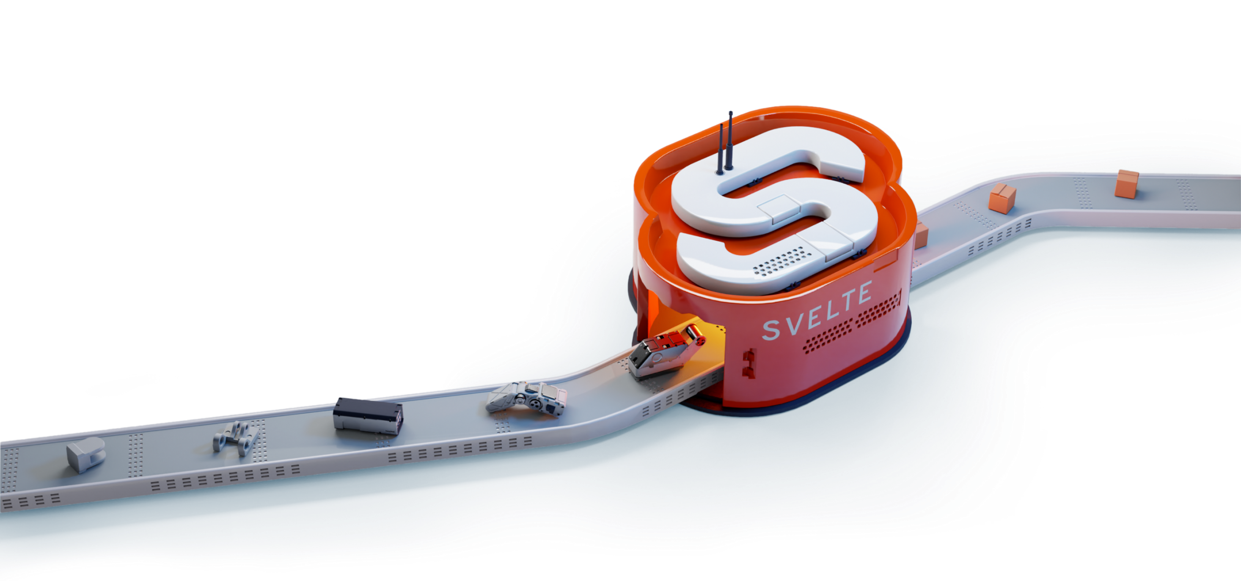
What is Svelte?

Slide 3
Svelte is a new JS Framework enabling clients to build web apps in a similar fashion to React, Angular and Vue. It includes all the features that are required for a modern JS Framework:
Reactivity
Component-driven approach
Use of modern compilers
Using TypeScript or ES
Svelte is a radical new approach to building user interfaces. Whereas traditional frameworks like React and Vue do the bulk of their work in the browser, Svelte shifts that work into a compile step that happens when you build your app.
- svelte.dev

Slide 4
How Svelte stands out
Less Code
No Virtual DOM
Truly Reactive
Syntax that makes it easier and faster to create components and build apps.
Unlike other JS Frameworks – no virtual DOM makes it run faster and much lighter.
Updates only the required DOM –makes apps fast and responsive.

Slide 5
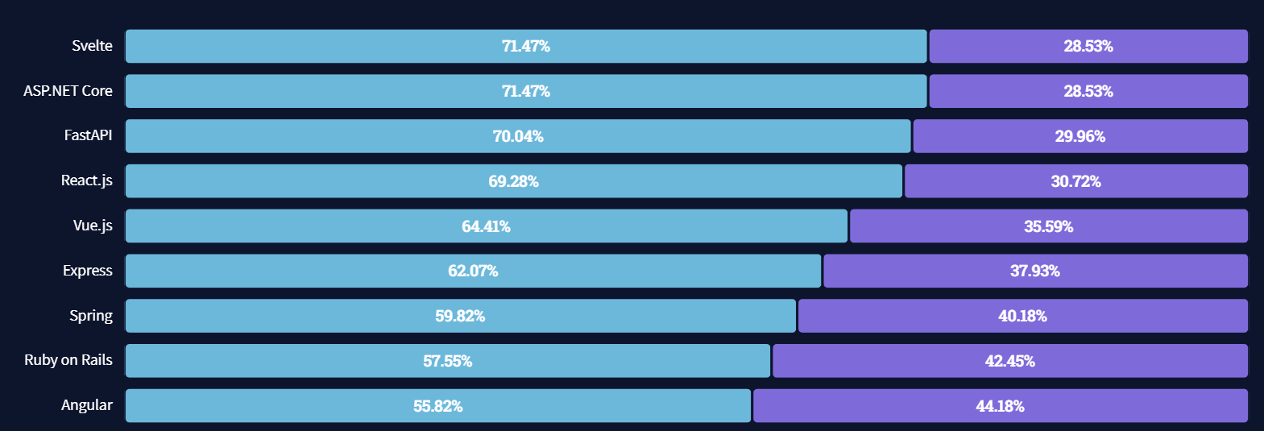
Stack Overflow
71.47% of the developers used Svelte loved it
https://insights.stackoverflow.com/survey/2021#section-most-loved-dreaded-and-wanted-web-frameworks

Slide 6
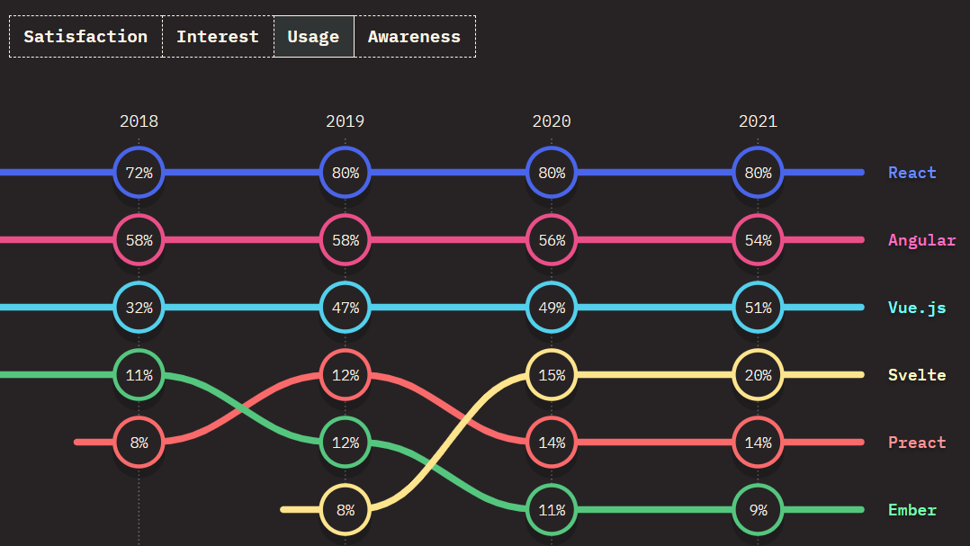
State of JS 2021
Usage is raised from 8% in 2019 to 20% in 2021.
https://2020.stateofjs.com/en-US/technologies/front-end-frameworks/

Slide 7
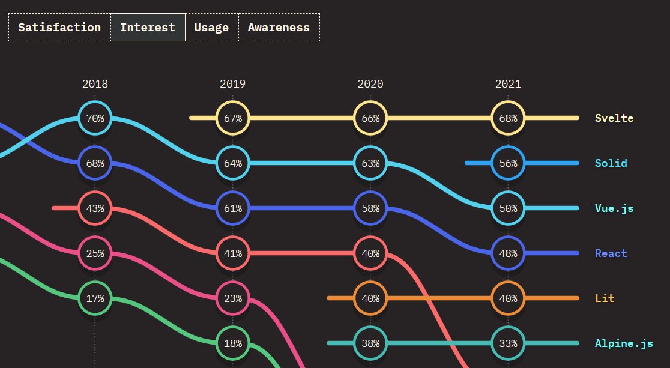
State of JS 2021
Top results in Interest since 2019 – more than 60%.
https://2020.stateofjs.com/en-US/technologies/front-end-frameworks/

Slide 8
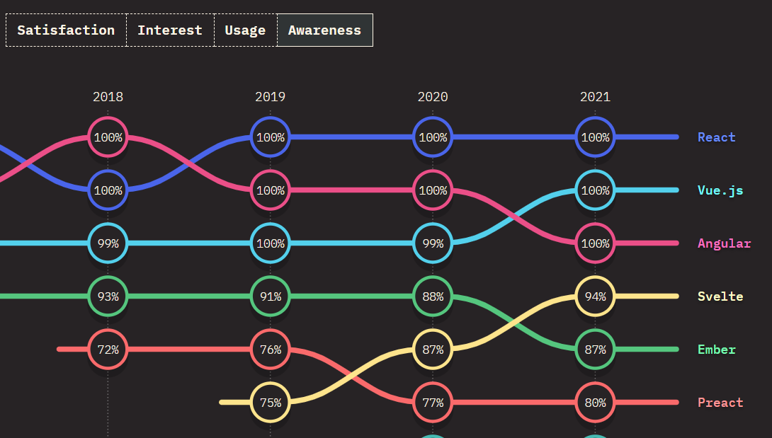
State of JS 2021
Awareness is raised from 75% in 2019 to 94% in 2021.
https://2020.stateofjs.com/en-US/technologies/front-end-frameworks/

Slide 9
What we Achieved
Created 5+ UI Svelte components: Grid, Pager, Calendar, Popup, TextBox, Button, Loader …
Created Sample App Sample app integrating the UI components created – GitHub Issues Grid.
POC - Svelte can be our next UI library

Slide 10
Svelte can be our Next UI Library
Svelte covers all major needs to build a modern web application.
It covers all the functionality and features that we need to build a UI library. And enrich our portfolio of support JS Frameworks.
Svelte is gaining popularity and usage. And we can be one of the first providing Svelte support.
* Carbon Design System has announced Svelte support, no official version up to now.

Slide 11
Check what we’ve built
Github repo: https://github.com/progress-hackatoners/kendo-svelte/
Sample App https://progress-hackatoners.github.io/kendo-svelte/
Progress Hackatoners Veselin Tsvetanov
Dimitar Kalaydzhiev
Yoana Ivanova
Yanko Dzhemerenov

